Slide 1
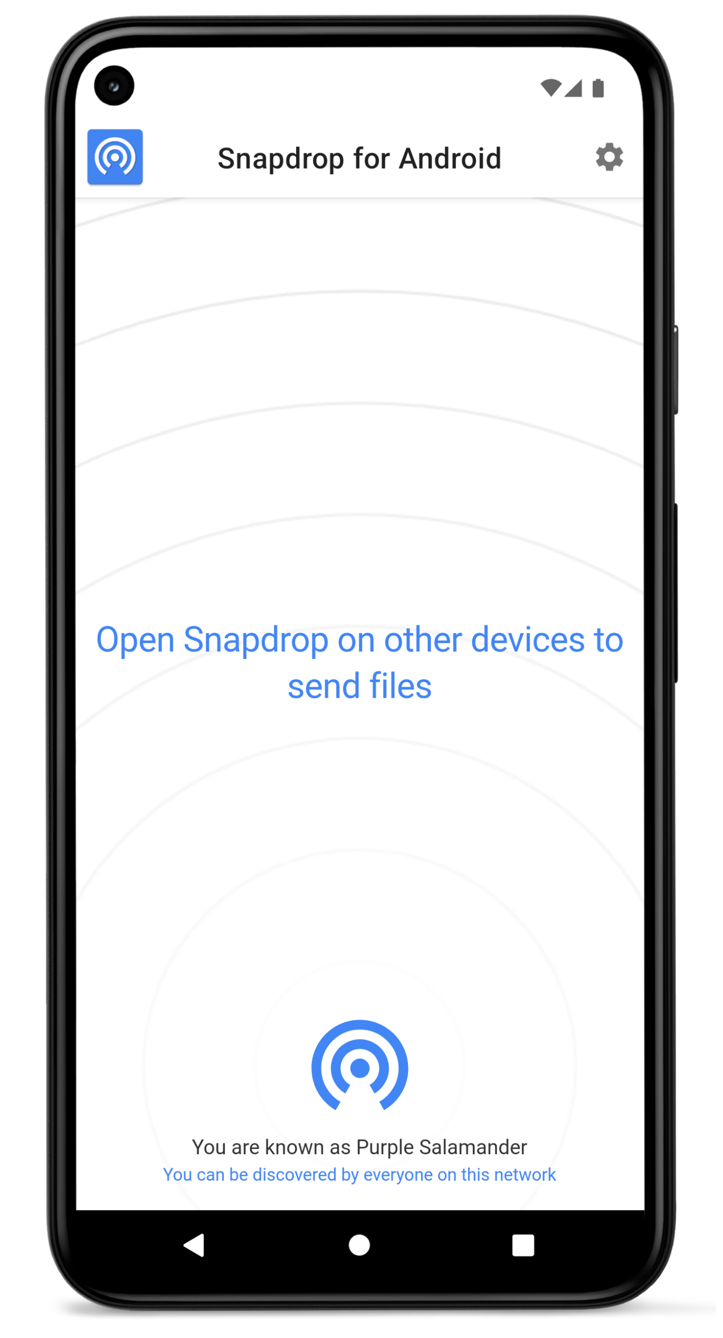
Filesharing
free and open source

Slide 2
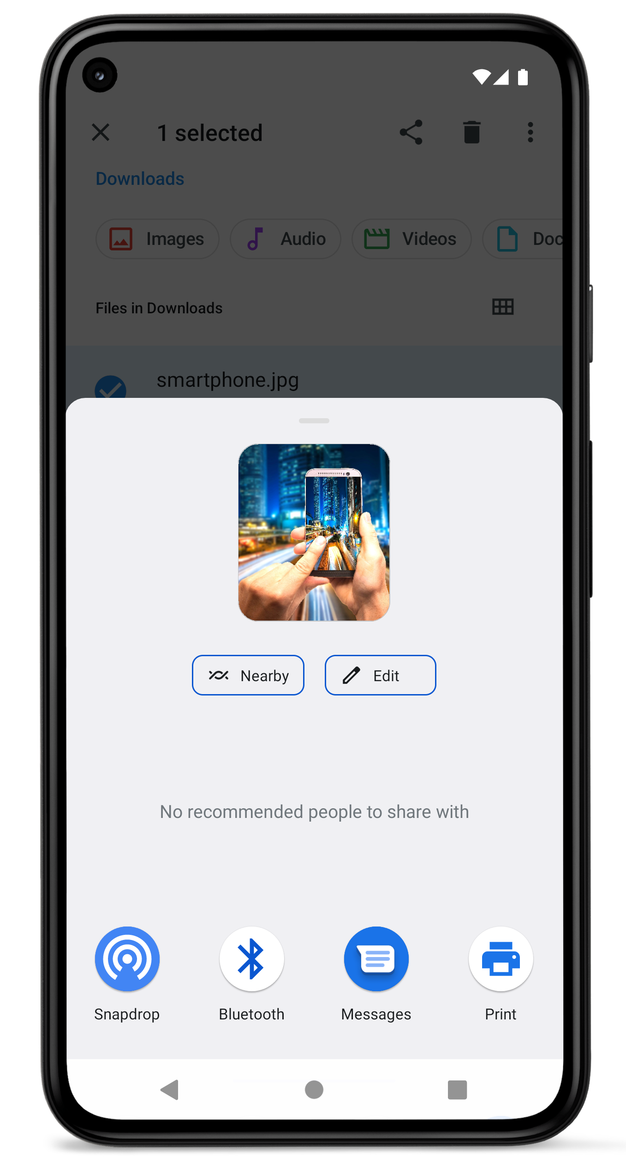
Easy sharing from within other apps

Slide 3
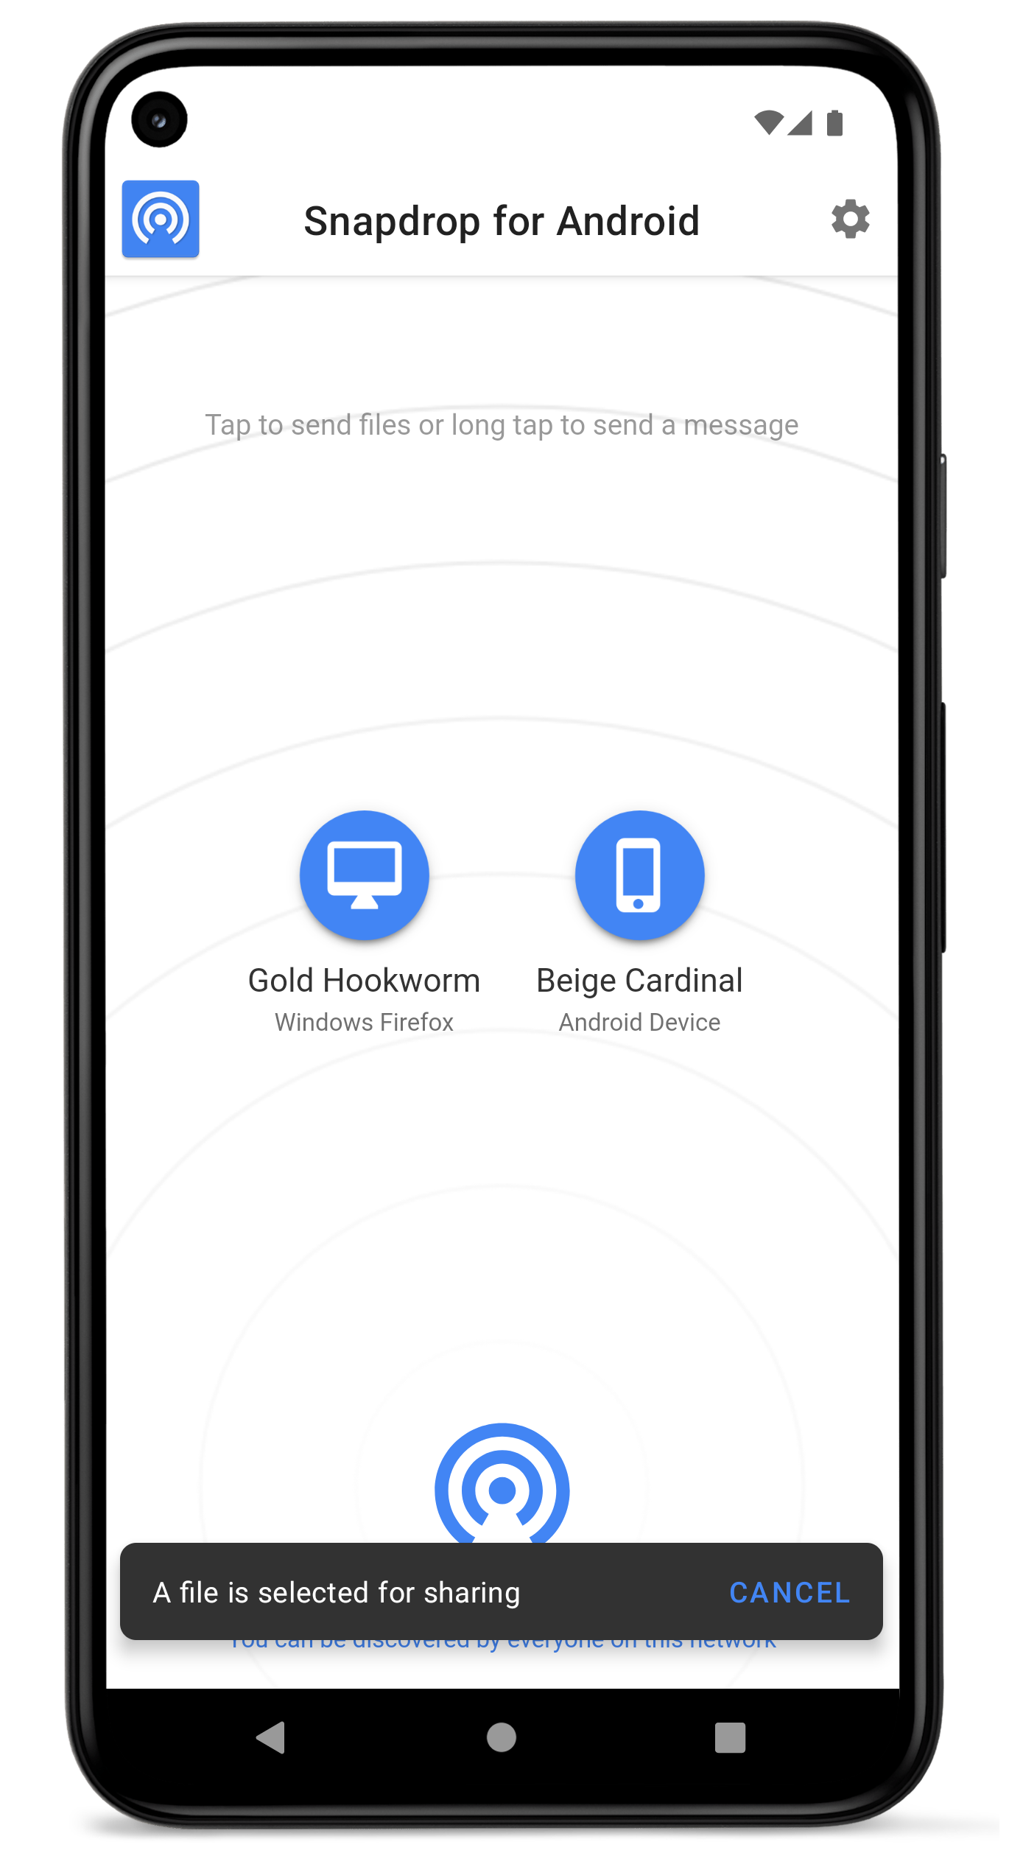
Send selected files
to multiple devices

Slide 4
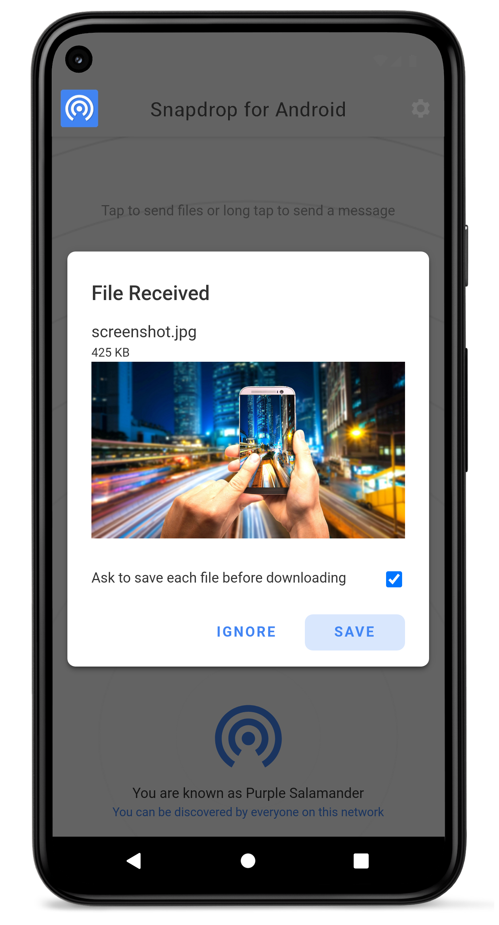
Easily save
received files

Slide 5
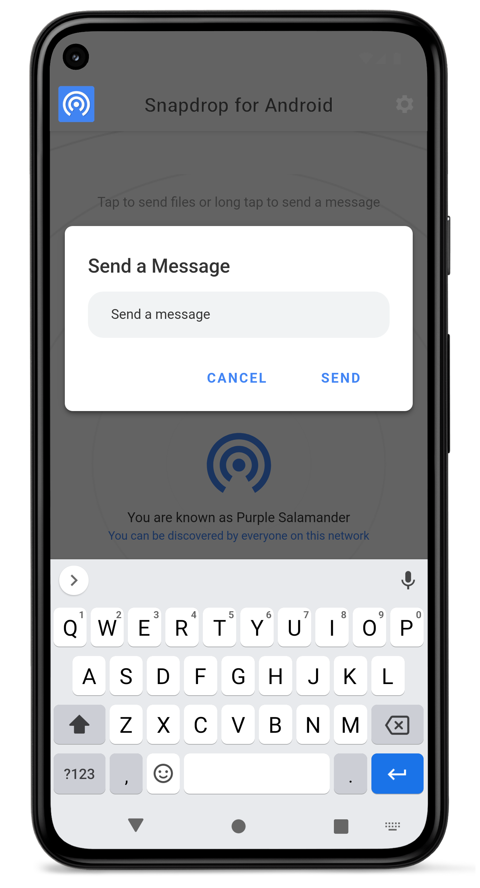
Long press to
send texts

Slide 6
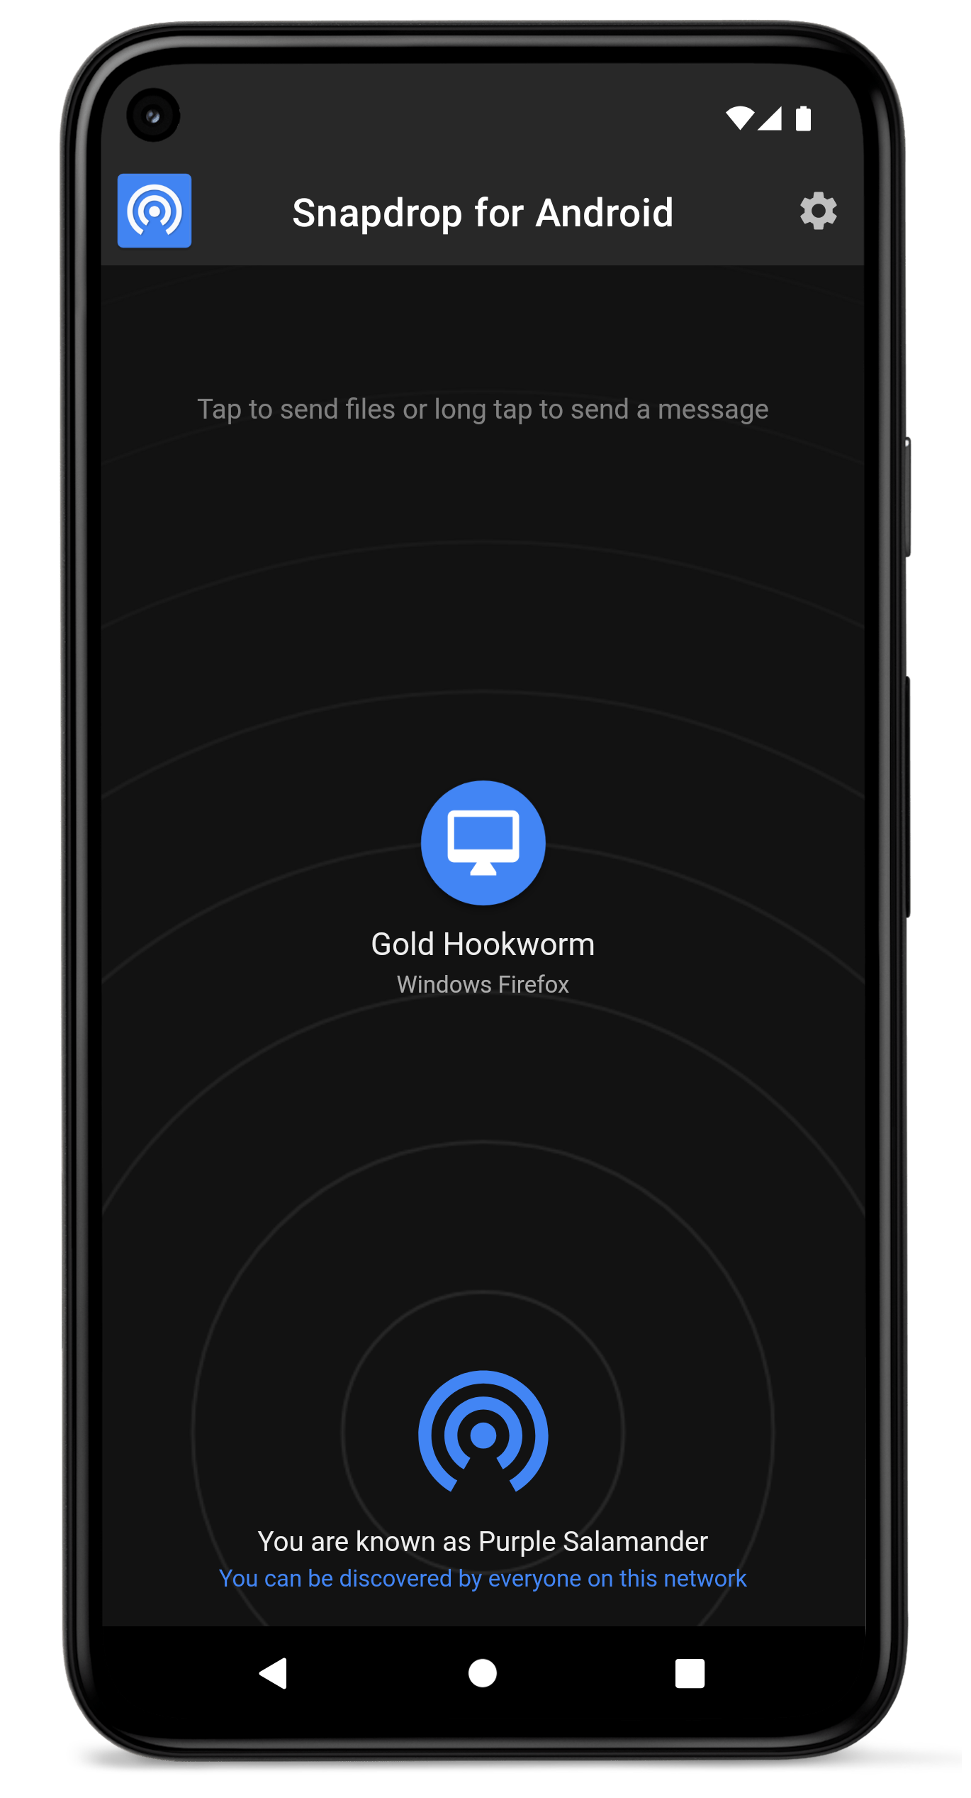
Turn it black
thanks to dark mode

Slide 7
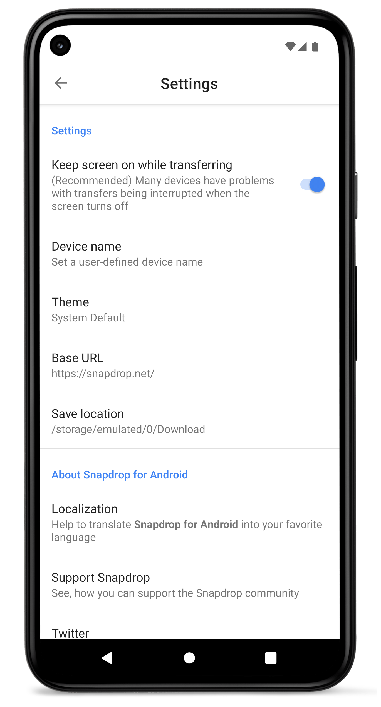
Personalize your
user experience

